Slide 1
DATA ANALYSIS ON DIWALI SALES USING PYTHON

Slide 2
INTRODUCTION
The Diwali Sales Analysis project focuses on analyzing the sales during the Diwali festival to gain insights into customer behaviour, improve customer experience , and optimize sales strategies.
By performing data cleaning, exploratory data analysis (EDA) ,and visualization techniques , we aim to identify patterns and trends in the data to make informed decisions.

Slide 3
DATA SET
The data set used for this analysis contains sales data during the Diwali festival, including details such as customer demographics , product categories , and sales quantities. It provides a comprehensive view of customer preferences and sales performance.

Slide 4
PROJECT GOALS
The main objectives of this analysis are as follows:
IDENTIFY POTENTIAL CUSTOMERS: Analyse customer demographics , including states, occupations, gender, and age groups , to identify potential customers. This information will help in targeting specific customer segments and tailoring marketing strategies to improve customer experience.
IDENTIFY MOST SELLING PRODUCT CATEGORIES AND PRODUCTS: Determine the product categories and specific products that have the highest sales during the Diwali festival. This insight will assist in planning inventory, ensuring product availability, and meeting customer demands.

Slide 5
METHODOLOGY
Data Loading: Load the Diwali sales dataset into the code using pandas library. Perform initial data exploration to understand the structure and content of the dataset.
Data Cleaning and Manipulation: Handle missing values, remove duplicates if any, and perform necessary data transformations. This step ensures the data is in a suitable format for analysis.
Exploratory Data Analysis (EDA): Use pandas, numpy, matplotlib, and seaborn libraries to explore the dataset. Analyze different variables, their distributions, and relationships. Generate various visualizations such as bar plots, pie charts, and scatter plots to uncover patterns and trends.

Slide 6
Customer Analysis: Analyze customer demographics such as states, occupations, gender, and age groups to identify potential customers. Use bar plots or pie charts to visualize the distribution of customers across different categories.
Product Sales Analysis: Determine the most selling product categories and specific products during the Diwali festival. Utilize bar plots or pie charts to visualize the sales quantities and identify the top-selling items.

Slide 7
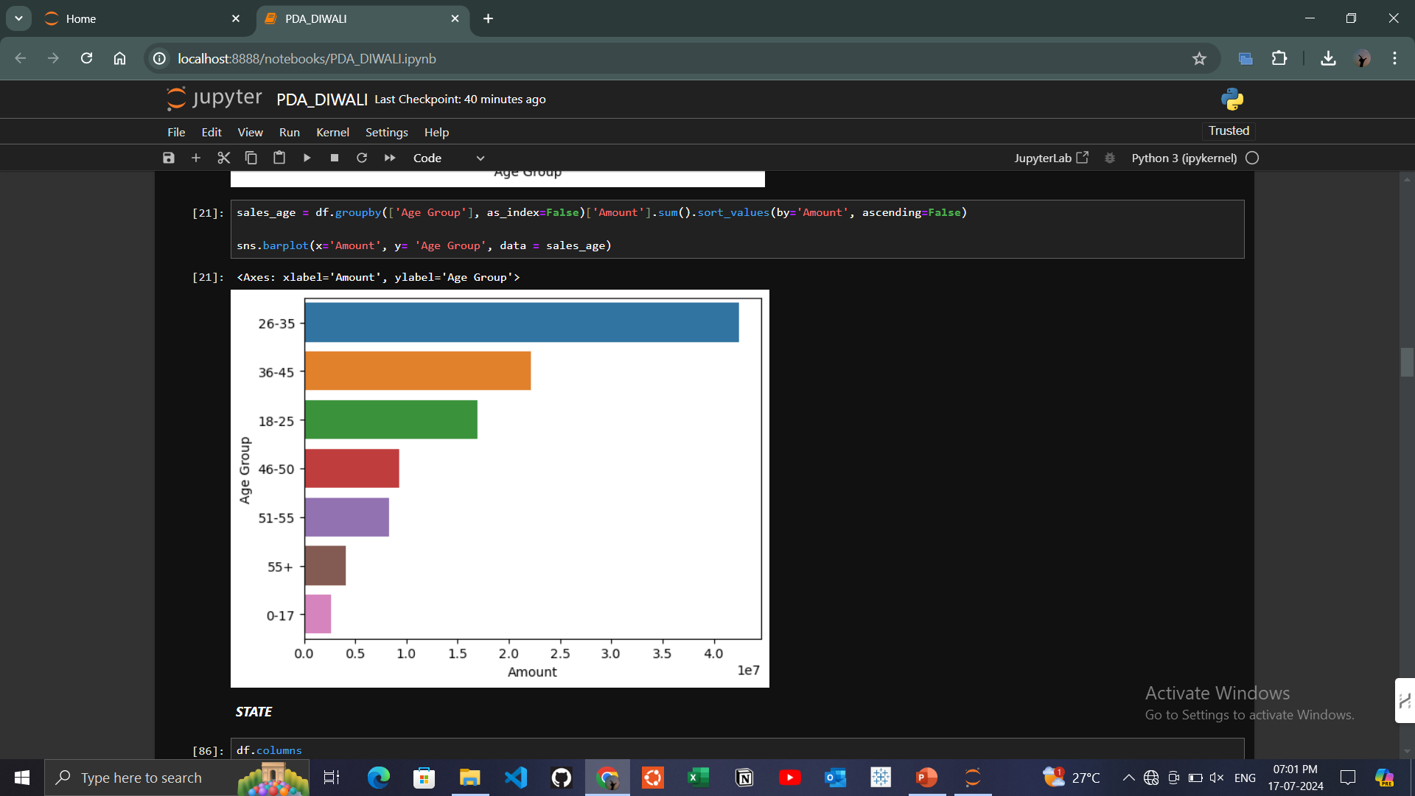
RESULTS:
Age group of 26-35 purchase more products.

Slide 8
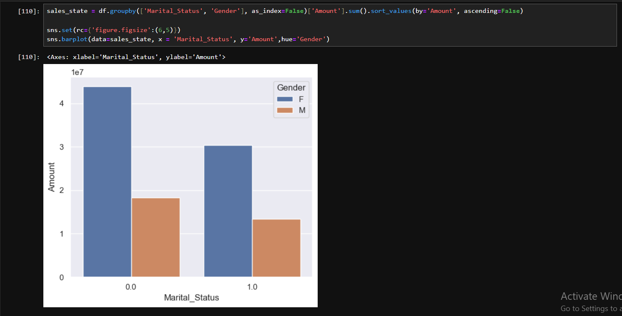
Females generally places more order and their purchase power is also higher

Slide 9
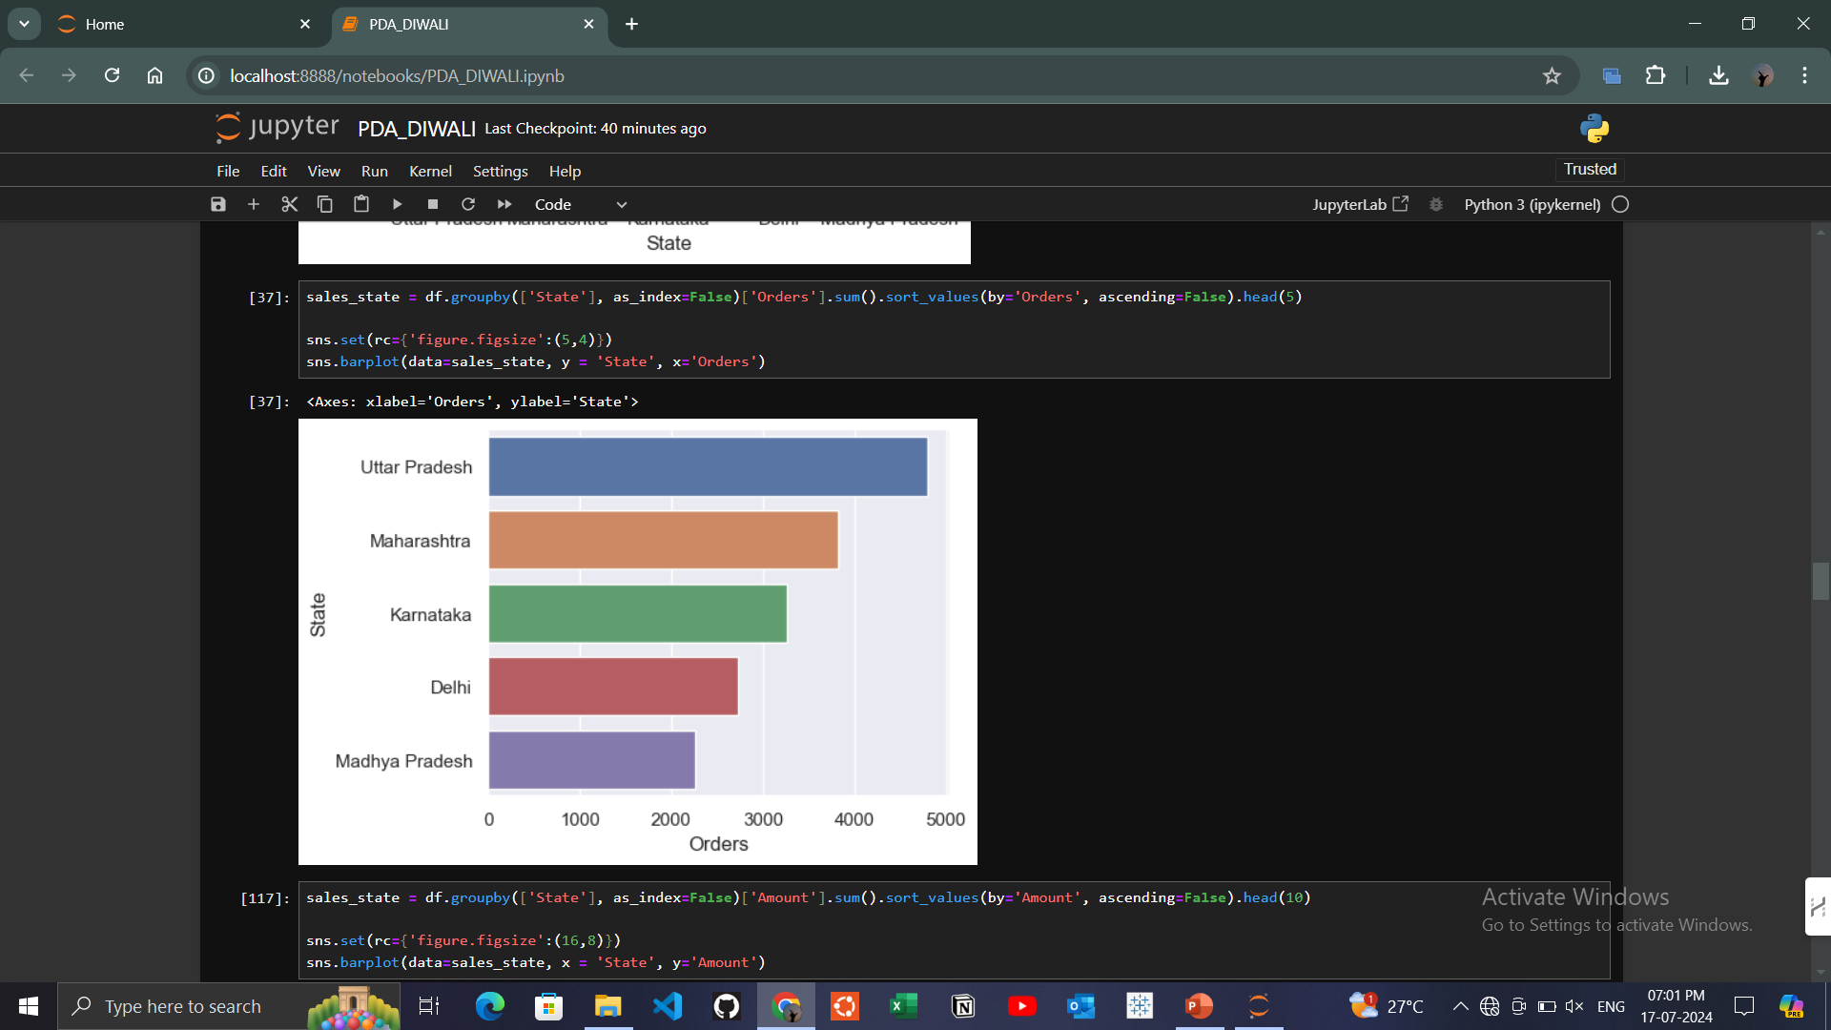
Here is the graph of TOP 5 States from where products were purchased.
Top 1 state of purchasing products is UTTAR PRADESH

Slide 10
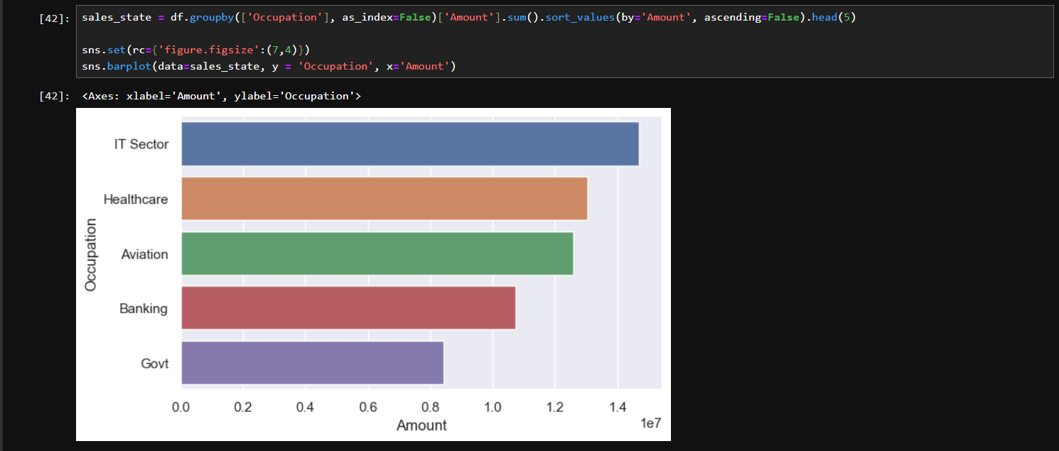
Here is the graph of top 5 occupations
Purchasers highly are from IT SECTOR, followed by HEALTH CARE and then AVIATION

Slide 11
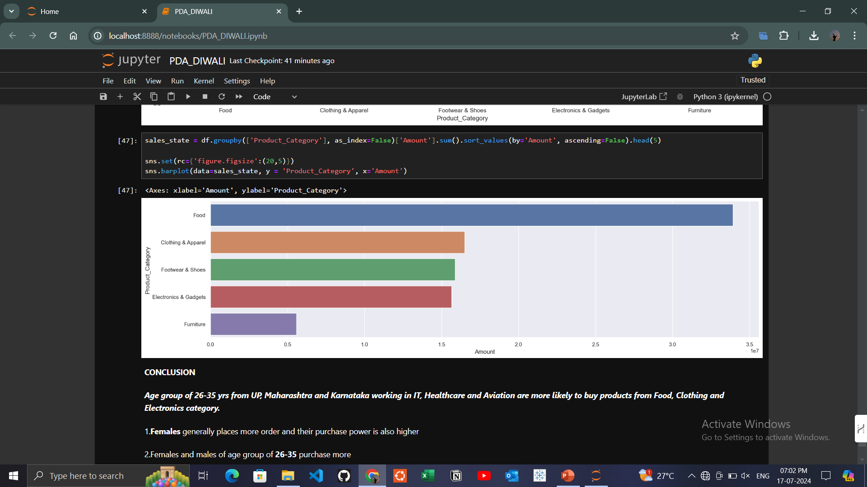
Here is the graph of TOP 5 products which were purchased
FOOD is the highly purchased product, followed by CLOTHING & APPAREL

Slide 12
DISCUSSION
Females generally places more order and their purchase power is also higher
Females and males of age group of 26-35 purchase more
Married females purchased more than unmarried , whereas unmarried females are high in number
Top 1 state of purchasing products is UTTAR PRADESH
Purchasers highly are from IT SECTOR, followed by HEALTH CARE and then AVIATION
FOOD is the highly purchased product, followed by CLOTHING & APPAREL

Slide 13
CONCLUSION
Diwali Sales Analysis project aims to improve customer experience and sales strategies by analyzing sales data during the festival. By performing data cleaning, exploratory data analysis, and visualization, we can gain insights into potential customers across different demographics and identify the most selling product categories and products. These insights will help optimize marketing strategies, plan inventory, and meet customer demands, leading to improved sales and customer satisfaction during the Diwali festival.

